Slide 1


Integrating a Virtual Machine on a system-on-a-chip
Boro Sitnikovski
Biljana Stojcevska

Slide 2
Introduction
Systems on a chip are all around us: elevators, smart TVs, smart ACs, smart refrigerators, etc.
The most trending application is the Internet of Things, where premises (households, hotels, medical centers, etc.) can be made “smart”.
  For example, automatically turn the lights on/off based on some sensor data, automatically lock/unlock a door, etc.

Slide 3
Programming a device
Once devices within a system (e.g. Internet of Things) are programmed, their code remains static until they are re-programmed again
Re-programming requires a programmer to be physically present at the device’s location. The programmer then connects to the device through a wire and can then flash the ROM
Our solution provides for a better programmer experience by
allowing these devices to be re-programmed on-the-fly

Slide 4
Virtual Machine on a chip
The idea is to flash the device’s ROM only once with a minimal VM that contains instructions which allows the programmer to control the board
We use a version of CHIP-8 - a tiny VM which was modified to contain additional instructions for controlling the device’s IO pins
Once the VM starts, it will pull a binary from the Internet which
will be the actual program that will execute on the device

Slide 5
Performance
MicroPython is another way to solve the re-programming problem. However, MicroPython has larger overhead and requires more memory and space for programs to run
Our Virtual Machine CHIP-8 is minimal and therefore has very little overhead on the device
In addition, we used a variant of the virtual machine in a formal verification project to ensure that the programs running on the SoC are correct

Slide 6
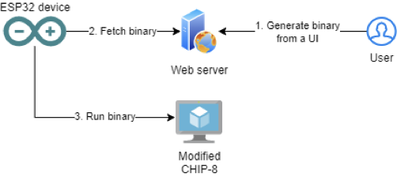
Virtual Machine on a chip
Since the binary pulled from the Internet can be changed, the code that the VM will execute can be dynamic - this does not require additional flashing of the ROM!

Slide 7
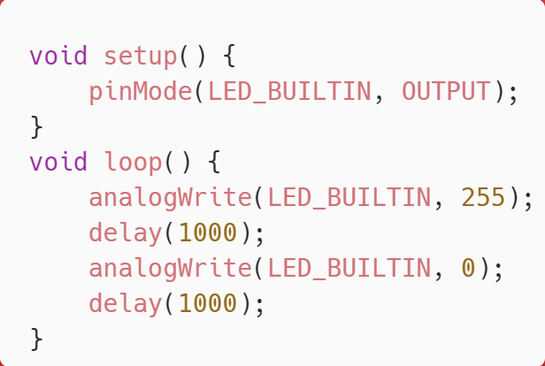
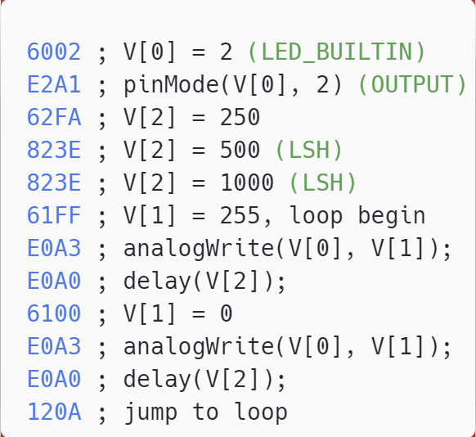
Arduino’s Blinker example
The C code for Blinker
CHIP-8 code for Blinker

Slide 8
Workflow Demo

Slide 9
Conclusion & future work
Flashing specific software to ROM is a common practice when it comes to SoCs. But as the nature of the chip requirements is ever-changing, it is practical to alter the functionality of the system without flashing it
In the paper, we presented a solution to this challenge by using an Arduino device (ESP WROOM32) as a proof-of-concept, together with a modified version of the CHIP-8 VM
The VM can be further extended to contain the necessary
instruction set that provides flexibility to the programmer

Slide 10
Thank you for your attention!

